Slide 1
Module 1: Lesson 1 – Harvesting Equipment
Notes:
This lesson is going to focus on the different kinds of harvesting equipment that are commonly found in Iowa. This is by no means an exhaustive list of all of kinds of harvesting machines, simply the ones common to Iowa

Slide 2
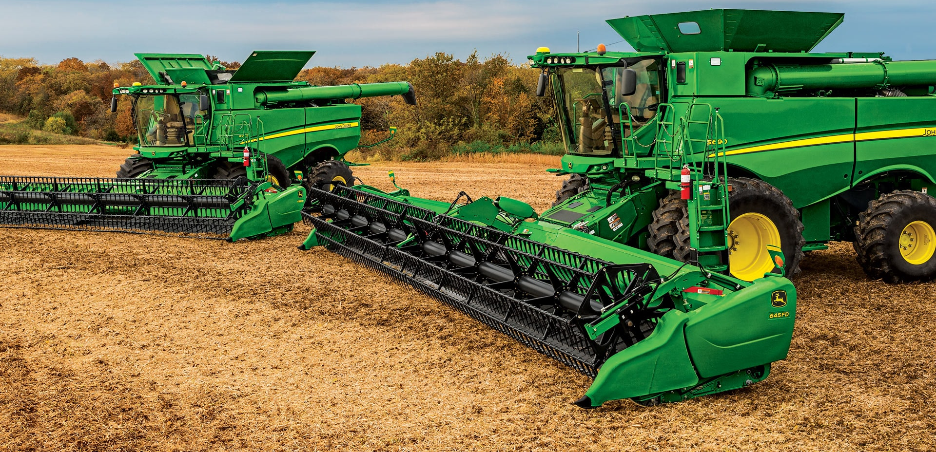
Why is Harvesting Equipment Important?
Ensures efficient crop collection with minimal losses
Reduces labor and harvesting time
Preserves crop quality and improves yield efficiency
Notes:
Harvesting equipment plays a vital role in modern farming by ensuring crops are collected efficiently, with minimal loss, and at the right time to preserve their quality. In Iowa, where we have large-scale row crop farms, efficient harvesting equipment allows farmers to cover hundreds or even thousands of acres quickly, reducing labor costs and improving yield efficiency. Without modern harvesters, it would take significantly longer to bring in the crops, and more would be lost due to shattering, weather damage, or inefficiencies

Slide 3
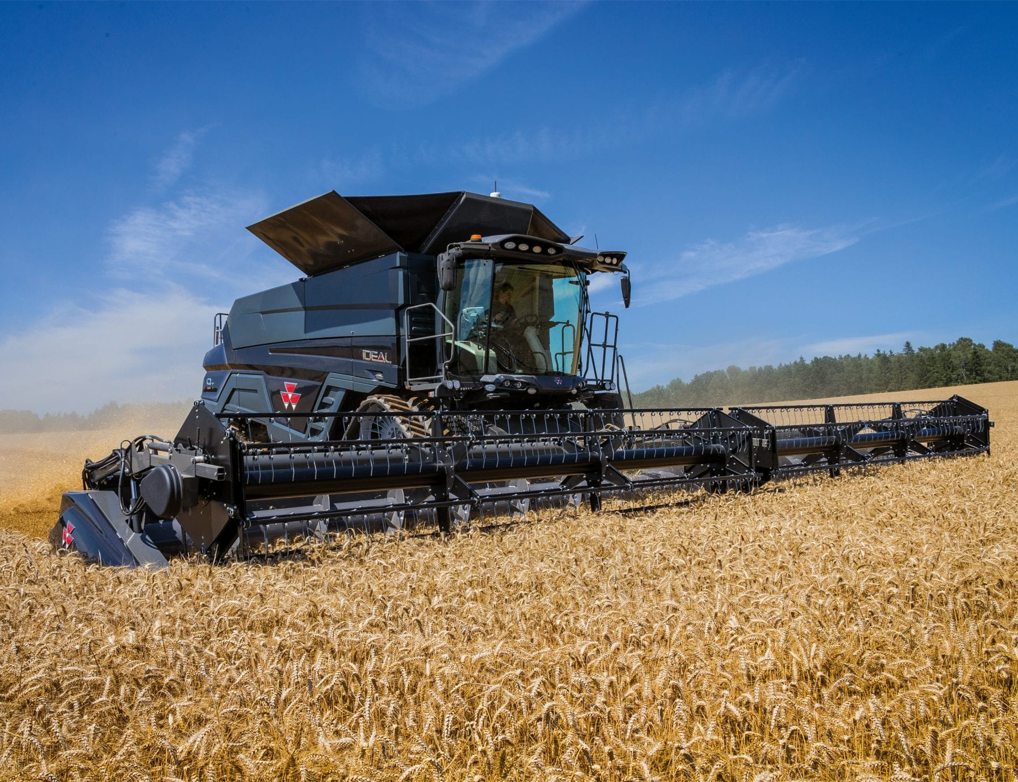
Combine Harvester
Cuts, threshes, and cleans grain crops in one operation
Best used for: corn, soybeans, wheat and a variety of other grains
Key Features: Interchangeable headers for different crops, onboard storage and automated yield monitoring
John Deere X9 Combine how it works animation
Notes:
The combine harvester is one of the most important machines in Iowa agriculture. It performs three key functions in a single pass: cutting, threshing, and cleaning grain crops. This is especially important for corn and soybeans—the two crops that cover the majority of Iowa’s farmland.
Modern combines have interchangeable headers that allow them to harvest different types of crops. They also feature onboard storage and automated yield monitors, which help farmers track their harvest data in real time

Slide 4
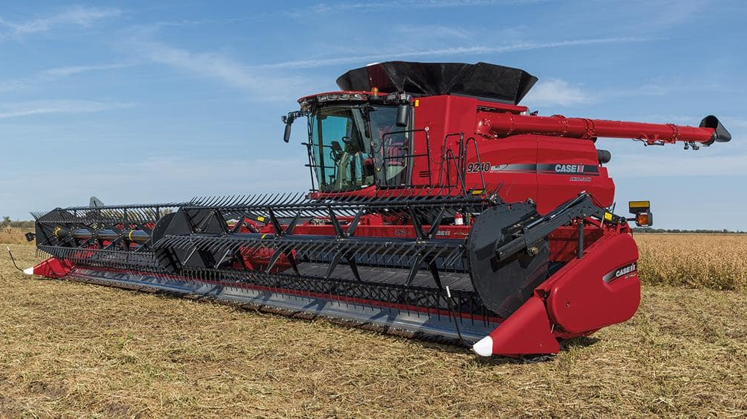
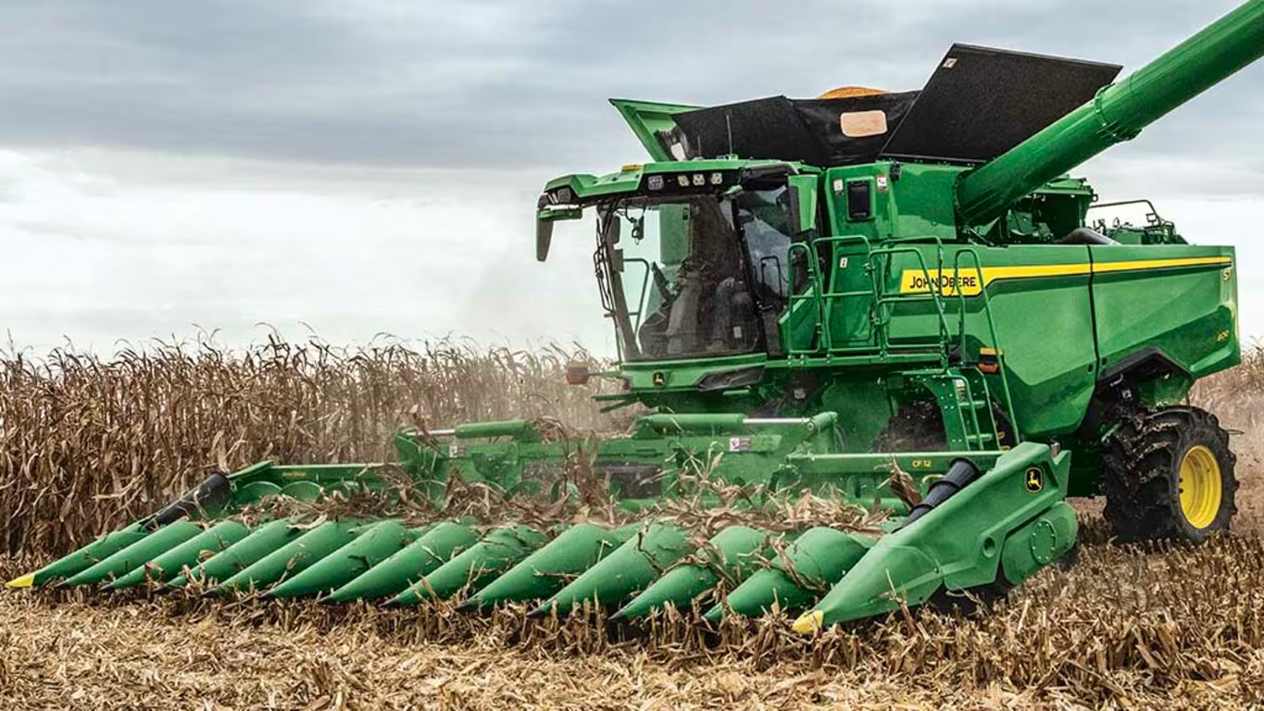
Draper head vs Corn head
John Deere | 600FD hydraFlex Draper Platform
CLAAS CORIO CONSPEED - YouTube
Uses a series of sickle blades and belts to gently cut and move crops to the center of the head before entering the combine
Best used for small grains like wheat, canola, and soybeans
Uses rotating stalk rolls to pull corn stalks downward, stripping the ears off and directing them into the combine
Best used for harvesting corn
Notes:
Depending on the crop being harvested, different headers are used on a combine.
Draper heads use a series of sickle blades and belts to gently cut and move crops like soybeans and wheat to the center of the head before feeding them into the combine.
Corn heads work differently. They use rotating stalk rolls to pull the corn stalk downward, stripping the ears off and directing them into the combine. This method is designed specifically for corn

Slide 5
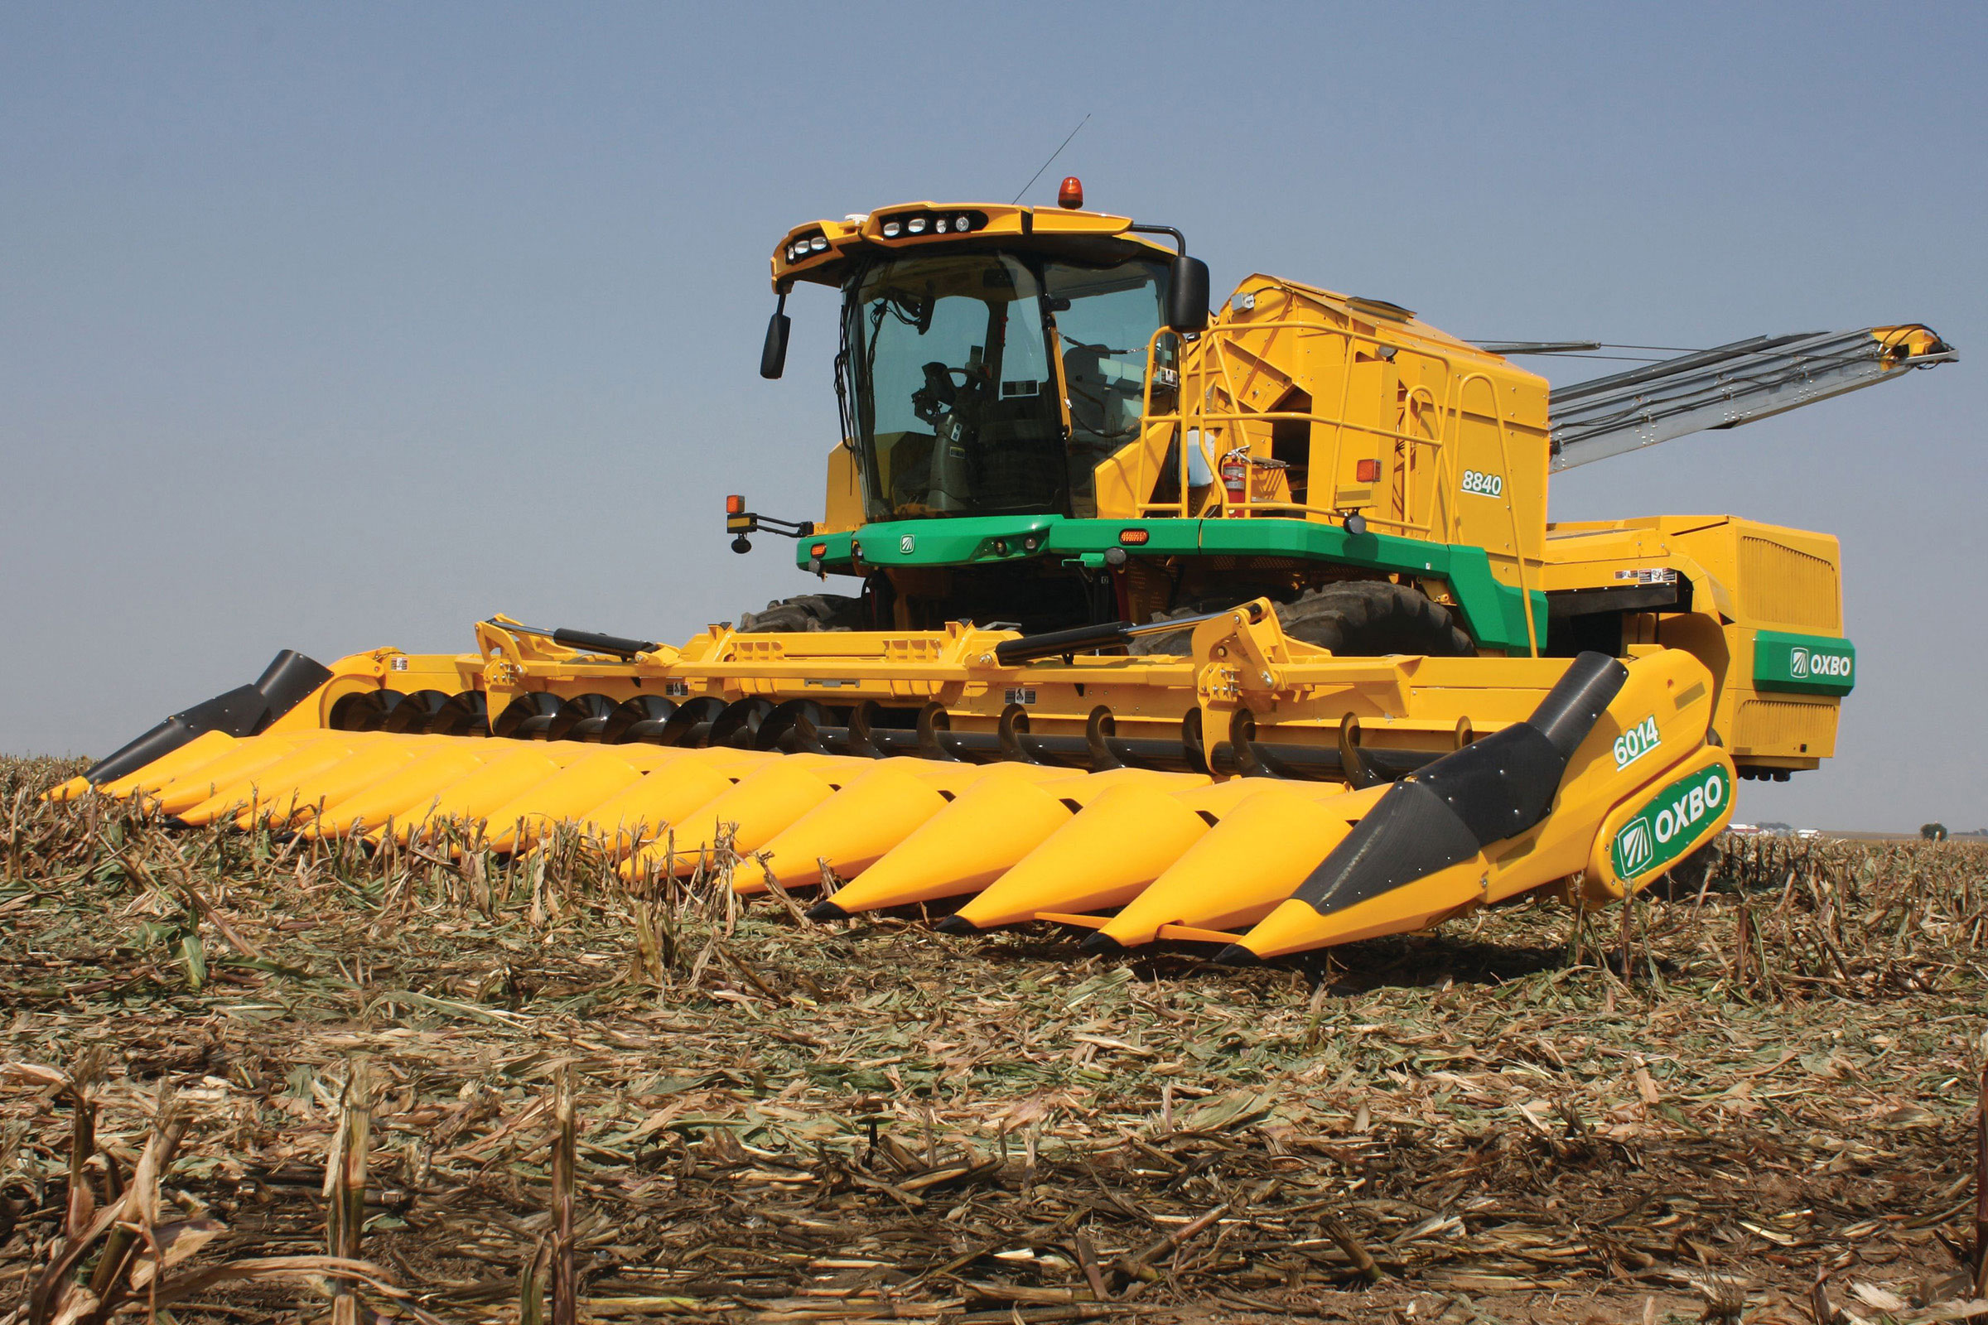
Seed Corn Harvester
Specially designed to harvest seed corn while maintaining kernel integrity
Best used for: Seed corn production
Key Features: Non-destructive, whole ear picking mechanisms, specialized husking beds, gentle handling to reserve seed viability.
8840 Revolutionary Seed Corn Harvester
Notes:
Unlike a regular combine, a seed corn harvester is specially designed to harvest seed corn while maintaining the kernel’s integrity. Seed corn is grown in specific fields and harvested differently than commercial corn because the kernels need to remain intact for planting the following year. These harvesters use non-destructive, whole-ear picking mechanisms and specialized husking beds to handle the corn gently. Iowa has a significant seed corn production industry, with major companies like Pioneer and Bayer producing hybrid seed varieties for farmers worldwide.

Slide 6
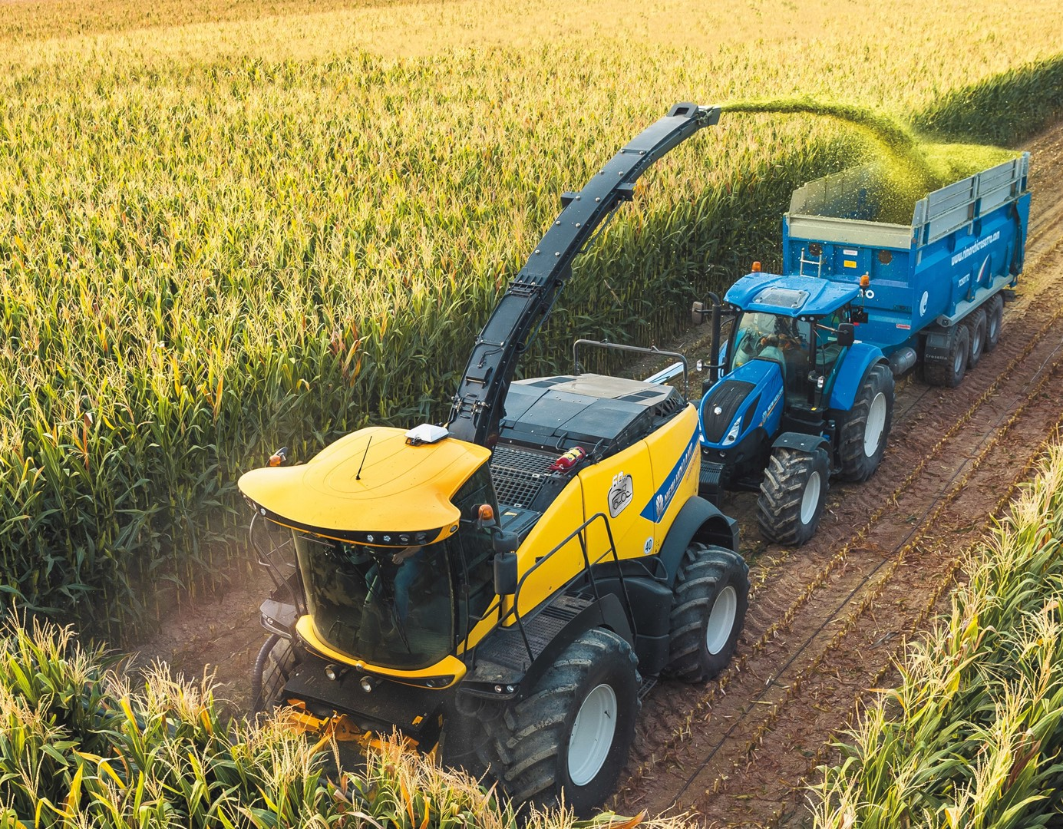
Forage Harvester
Cuts and chops forage crops for silage, ensuring optimal feed quality
Best used for: corn silage, alfalfa, grasses
Key Features: High capacity chopping system and adjustable cutting length
John Deere | 9000 Series Animation Cropflow
Notes:
In addition to grain crops, Iowa farmers also produce silage—fermented, high-moisture feed used for livestock, especially dairy and beef cattle.
A forage harvester cuts and chops plants like corn, alfalfa, and grasses into small pieces that can be stored in silos or bunkers for feed. The ability to adjust the cutting length helps farmers provide the best feed quality for their livestock.

Slide 7
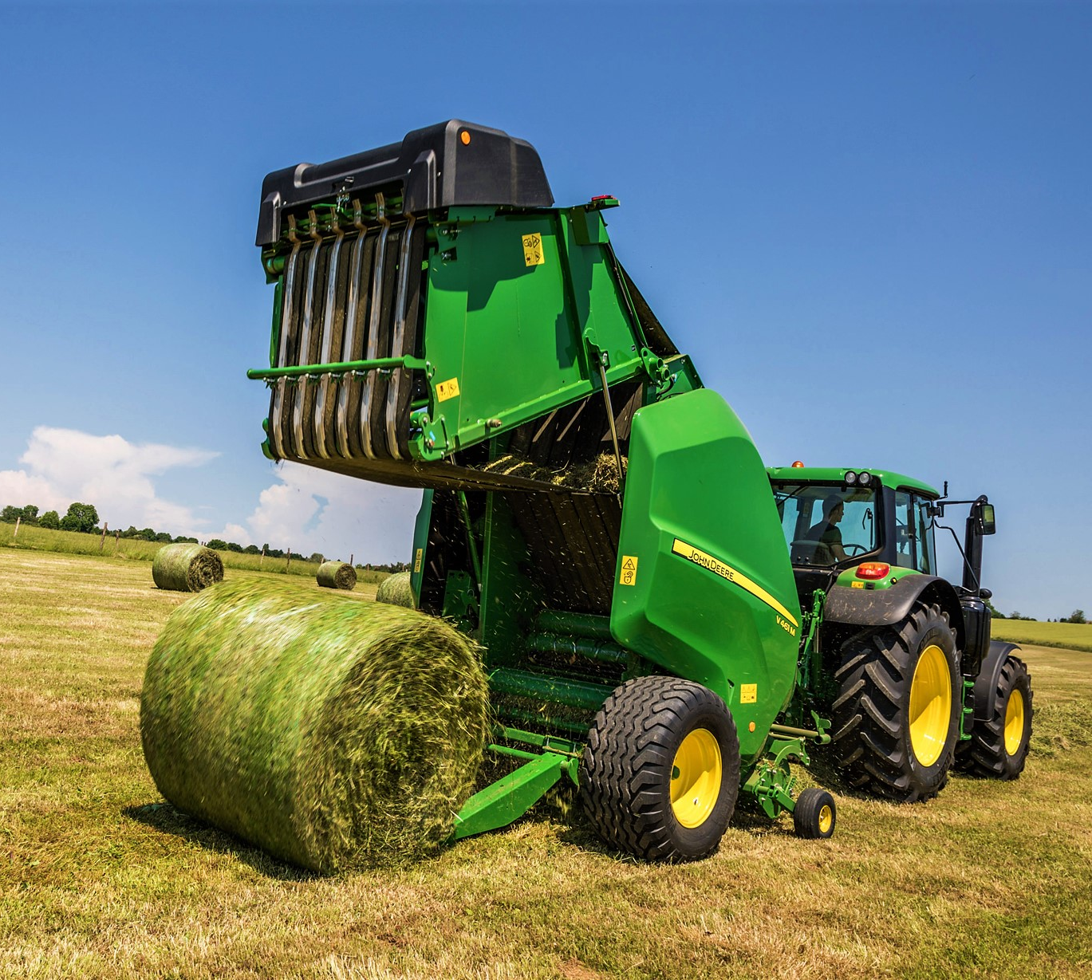
Round Balers
Rolls cut hay, straw or silage into cylindrical bales for storage and/or transport
Best used for: Hay, straw forage crops
Key Features: Variable or fixed chamber designs, net or twine wrapping options, adjustable bale diameters
Massey Ferguson 2800 Baler Animation - YouTube
Notes:
After forage crops like hay and straw are cut and dried, they need to be baled for storage and transport. Round balers create cylindrical bales that are easier to handle and can be wrapped in plastic to preserve moisture content. In Iowa, round bales are commonly used in beef cattle and dairy operations, providing a stable feed source throughout the winter. Farmers can adjust the bale diameter and choose between net or twine wrapping to best suit their storage and feeding needs

Slide 8
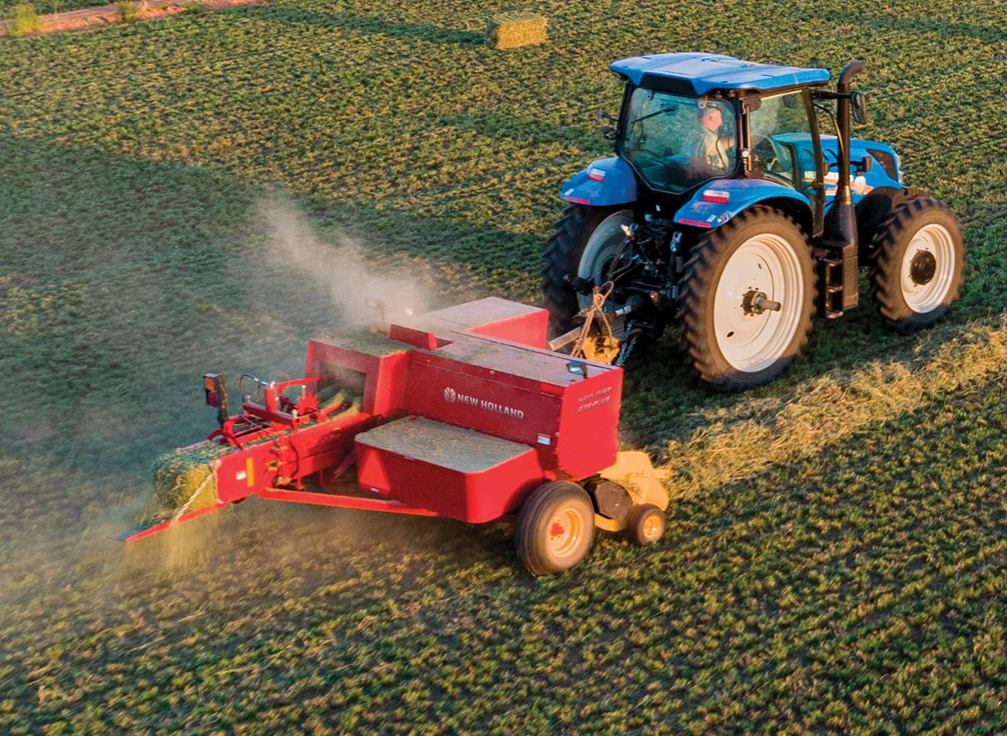
Square Balers
Compresses hay, straw, or silage into rectangular bales for easier stacking and transport
Best used for: Hay, straw forage crops
Key Features: Consistent bale shape, high-density packing, automated tying twine tying systems
How it works: BigBaler High Density Large Square Hay Baler
Notes:
Unlike round balers, square balers compress hay or straw into rectangular bales. These are easier to stack and transport, making them a popular choice for large livestock operations and commercial hay producers. Because they create a consistent shape and high-density packing, they’re ideal for storing large amounts of forage efficiently.

Slide 9
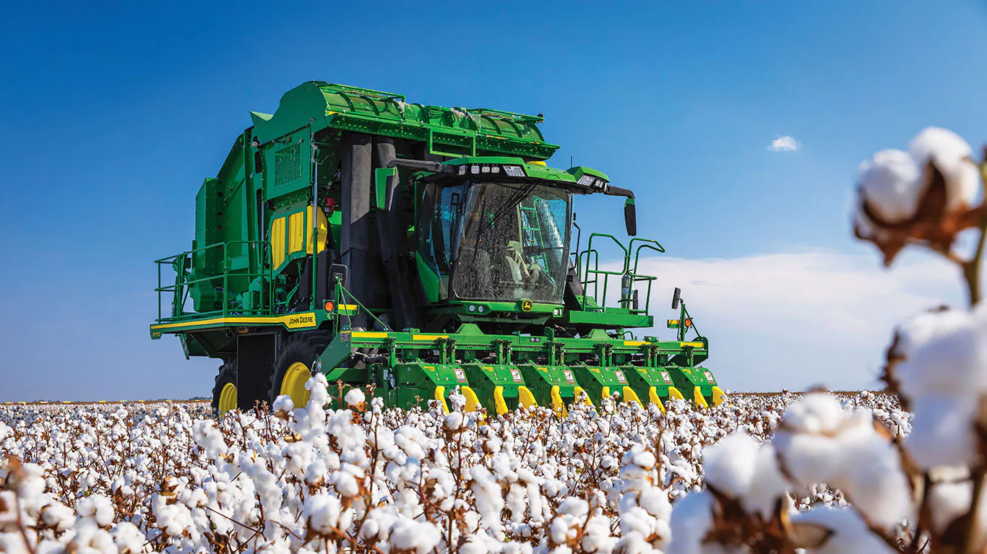
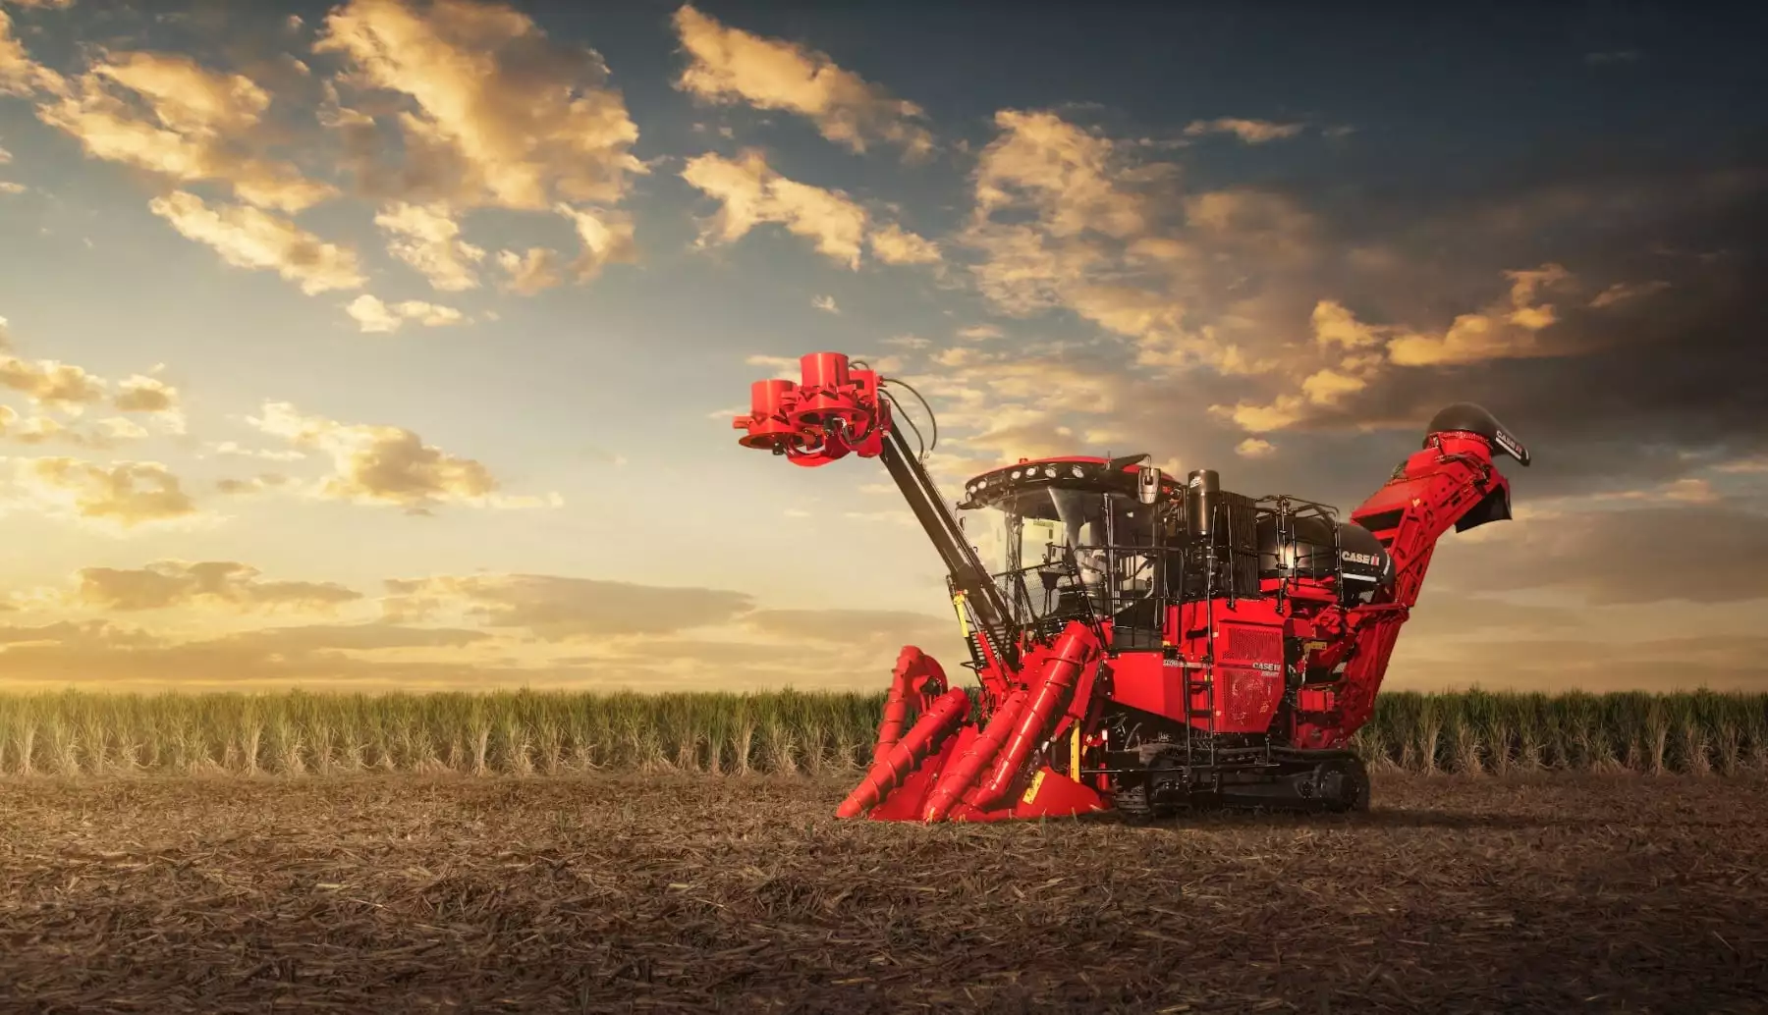
Specialty Harvesting Equipment
Cotton Picker Sugar Cane Harvester
Notes:
We won’t go into the details on these machines because it is extremely rare that they would ever be used in Iowa. This is certainly not all of the specialty harvesting equipment that exists, just the more common ones.
Really, these two just look really cool, so we wanted to include them.

Slide 10
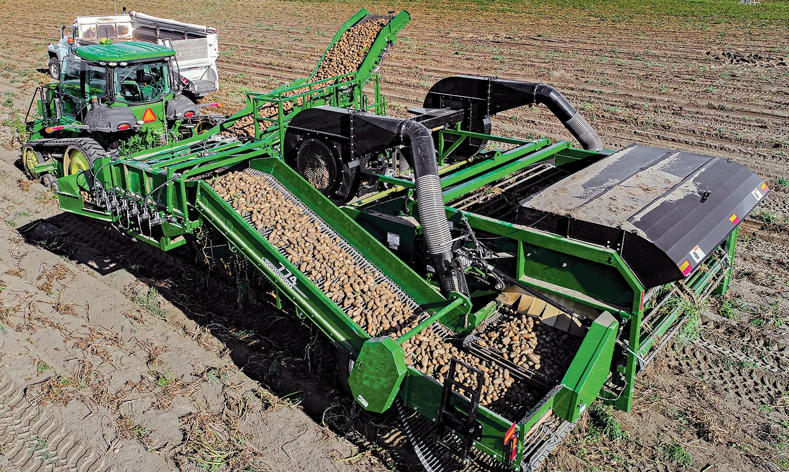
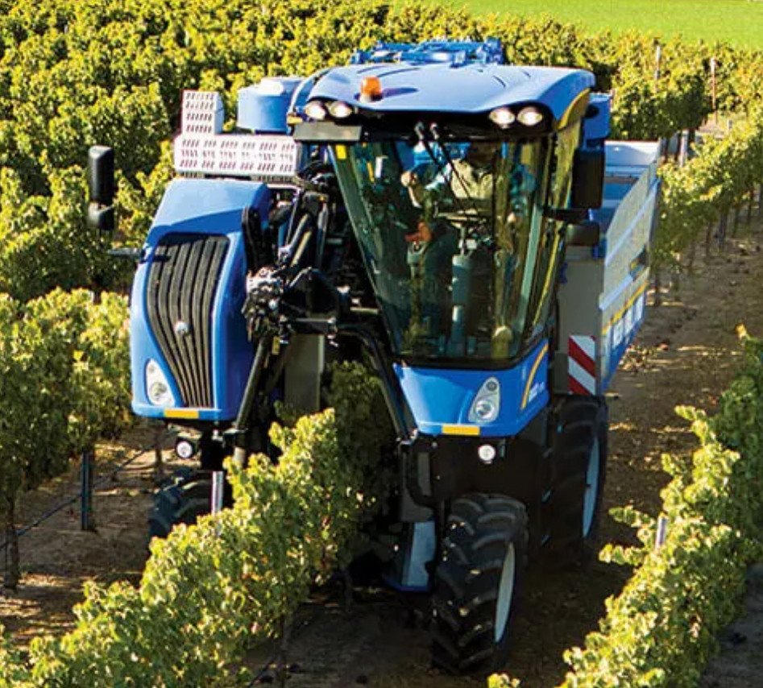
Specialty Harvesting Equipment
Potato Harvester Grape Harvester
Notes:
We won’t go into the details on these machines because they are very rarely (if ever) used in Iowa. This is certainly not all of the specialty harvesting equipment that exists, just the more common ones.

Slide 11
Factors to Consider when Choosing Equipment
Crop type and size
Field size and terrain
Labor availability
Budget and maintenance costs
Notes:
When selecting harvesting equipment, farmers consider several factors, including:
Crop type and size: Different crops require different harvesting methods.
Field size and terrain: Large flat fields are suited for bigger equipment, while smaller or hilly fields may require different machines.
Labor availability: With fewer farmworkers available, automated equipment is becoming more popular.
Budget and maintenance costs: Newer machines offer advanced technology but come with higher costs, while older equipment may require more upkeep

